Slide 1

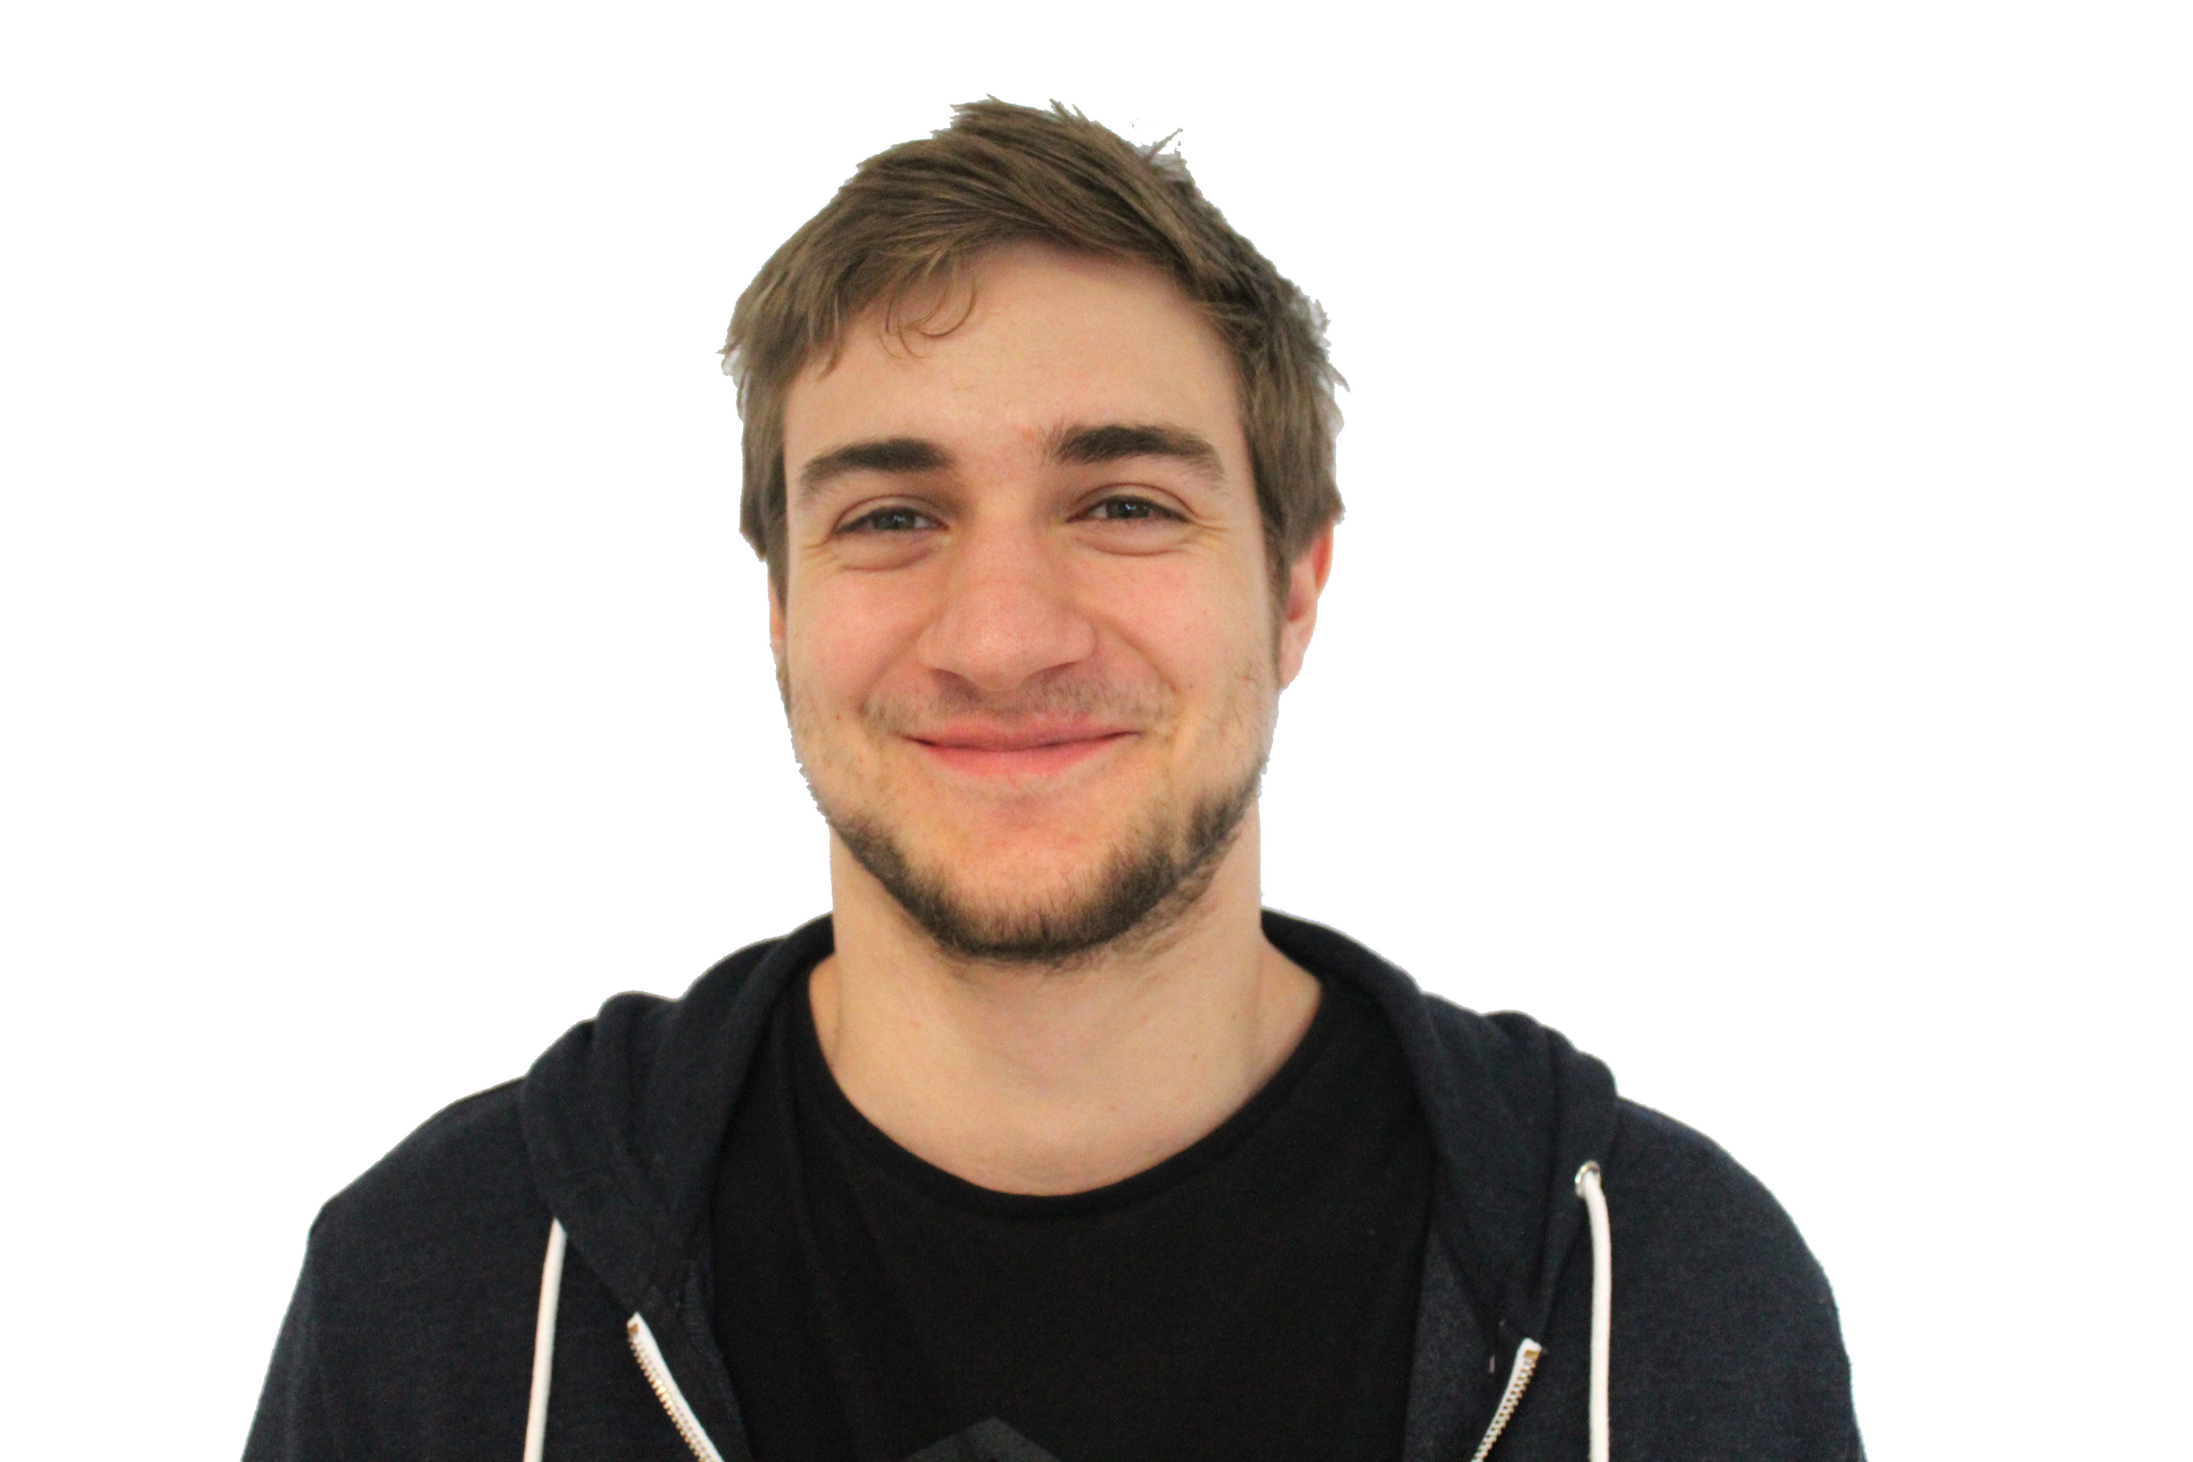

Internship SDSoC
Andrew Maclellan

Slide 2
Introduction
What is SDSoC?
Software Defined System on Chip.
Accelerate software functions (C/C++) within the FPGA on Zynq devices.
Aimed at software engineers with limited hardware knowledge.
Runs on top of Vivado, Viavado HLS, and SDK.

Slide 3
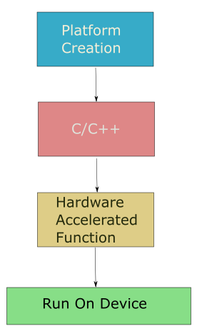
SDSoC Structure
Platform created in Vivado and linked to SDSoC.
C/C++ program written in SDSoC.
Selected functions are built into hardware.
Run on device through JTAG or booted from SD card.

Slide 4
SDSoC Features
Hardware acceleration
Automatically creates boot files for baremetal, linux, and FreeRTOS.
Vivado HLS pragmas. (Pipeling, unrolling etc…)
Estimation Reports (Comparing software only to hardware accelerated).
Axi Performance Interface.

Slide 5
Learning
Zynq Book.
2 day training course SDSoC (Rutherford Appleton Laboratory).
Creating own platform.
Using HLS pragmas.
Writing software to be synthesisable in hardware.

Slide 6
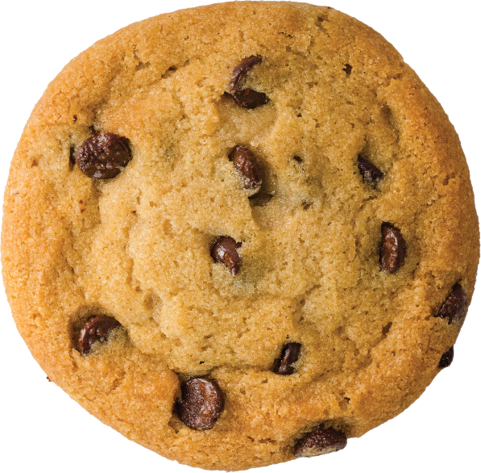
Application of SDSoC
Zybo.
Image processing.
Following SDSoC structure.
Program for hardware.
Create filters for:
Pass-through and colour change.
Greyscale.
Average Filter.
Sobel Filter.

Slide 7
Platform
Zybo Digilent platform.
HDMI_in, VGA_out, CLKs, GPIO…

Slide 8
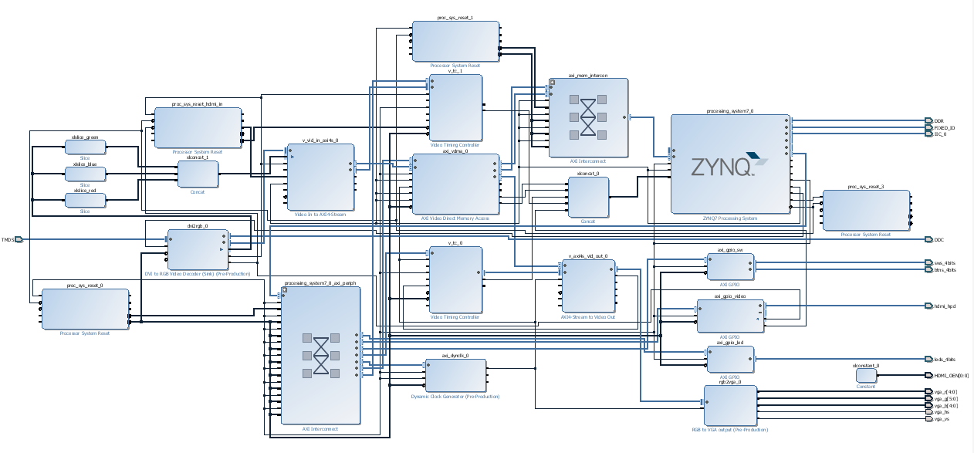

Slide 9
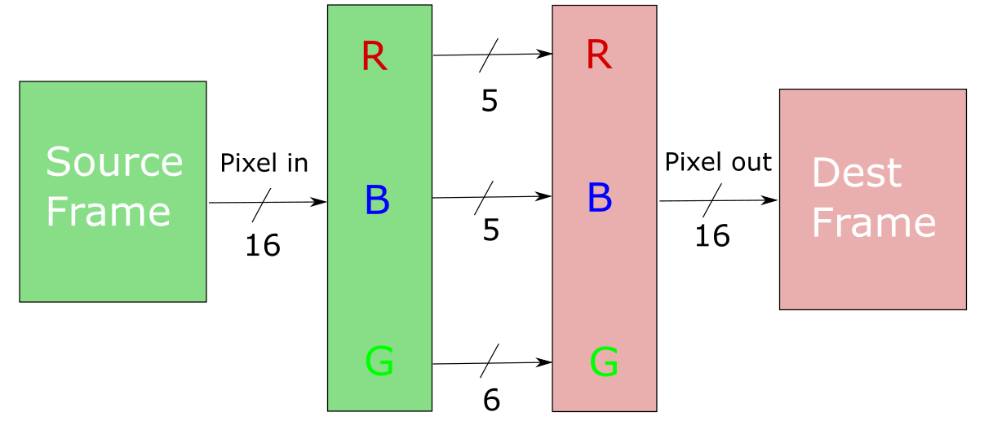
Pass-through

Slide 10
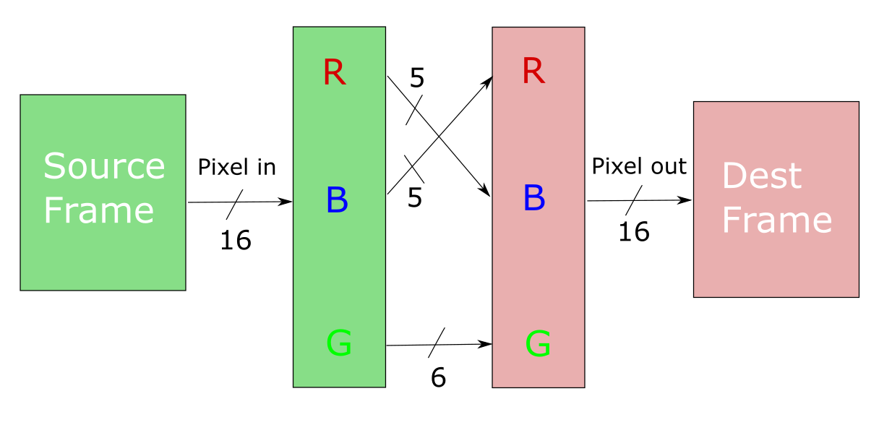
Pass-through

Slide 11

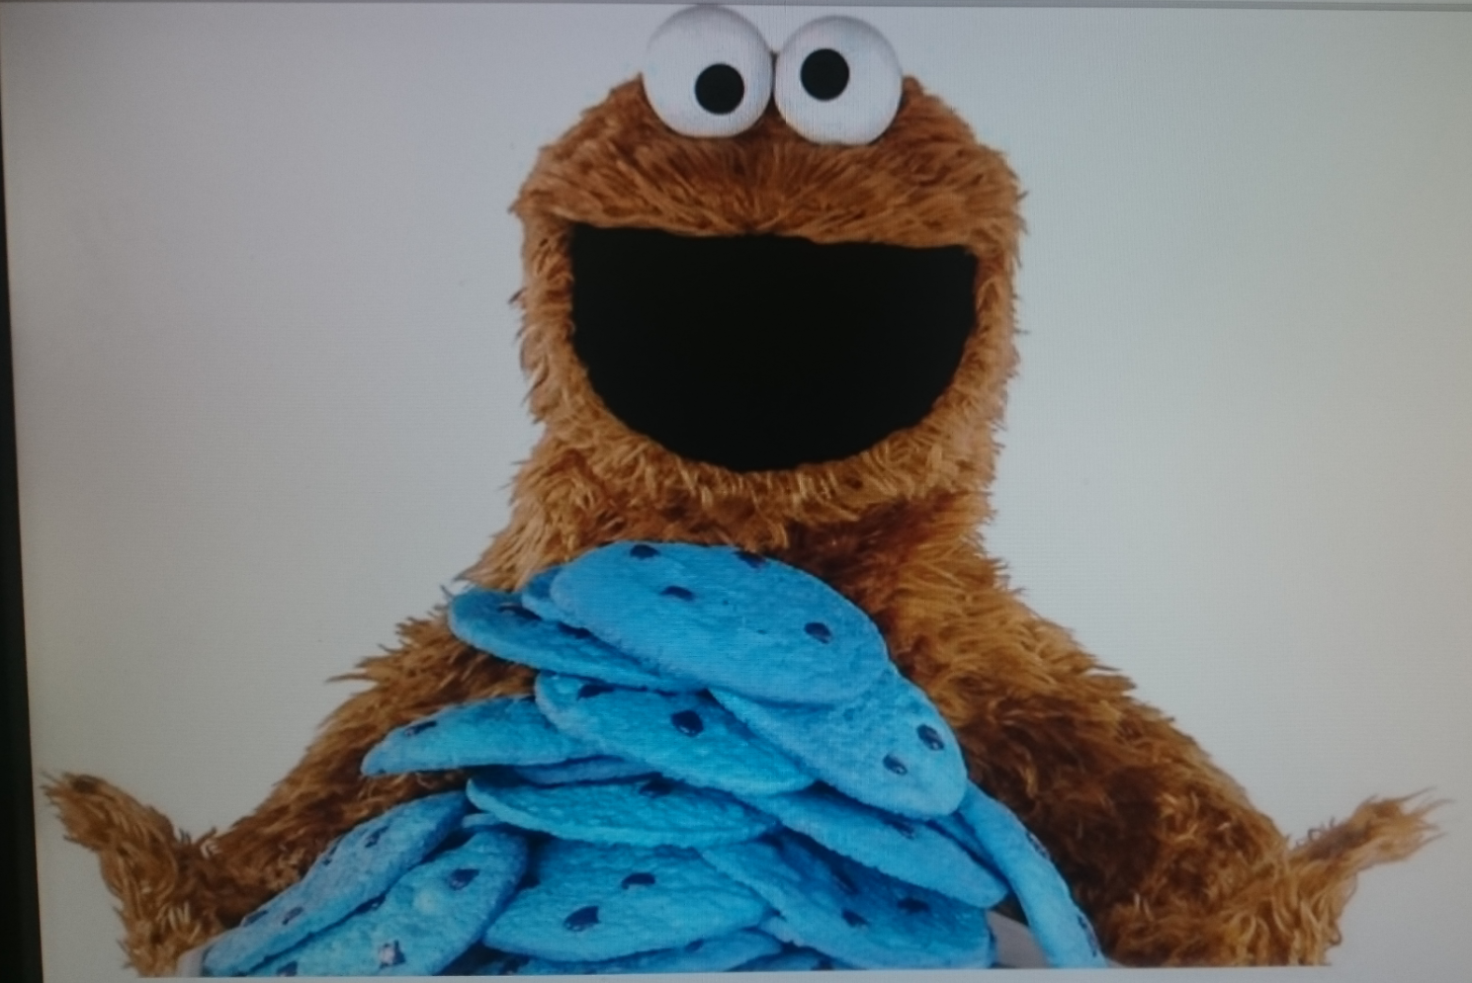

Slide 12
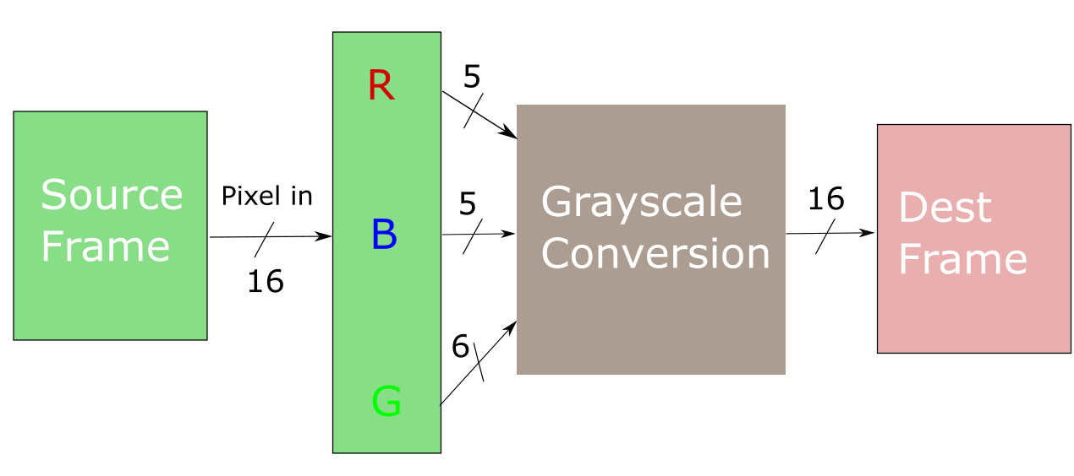
Grayscale

Slide 13

Greyscale
Y = (R * 76) + (B * 150) + (G * 29 + 128) >> 8

Slide 14

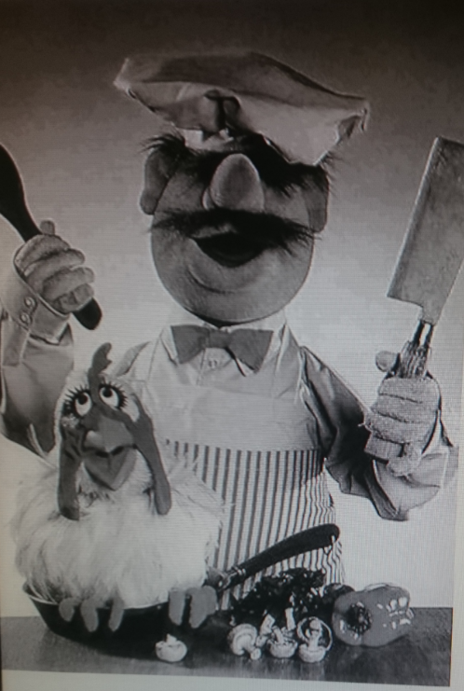

Slide 15
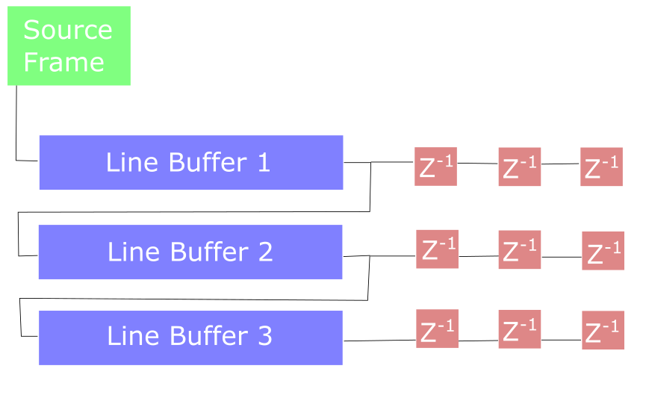
Average Filter

Slide 16
Average Filter
Z_Average = (Z1 + Z2 + Z3 + Z4 + Z5 + Z6 + Z7 + Z8 + Z9) * 1/9

Slide 17

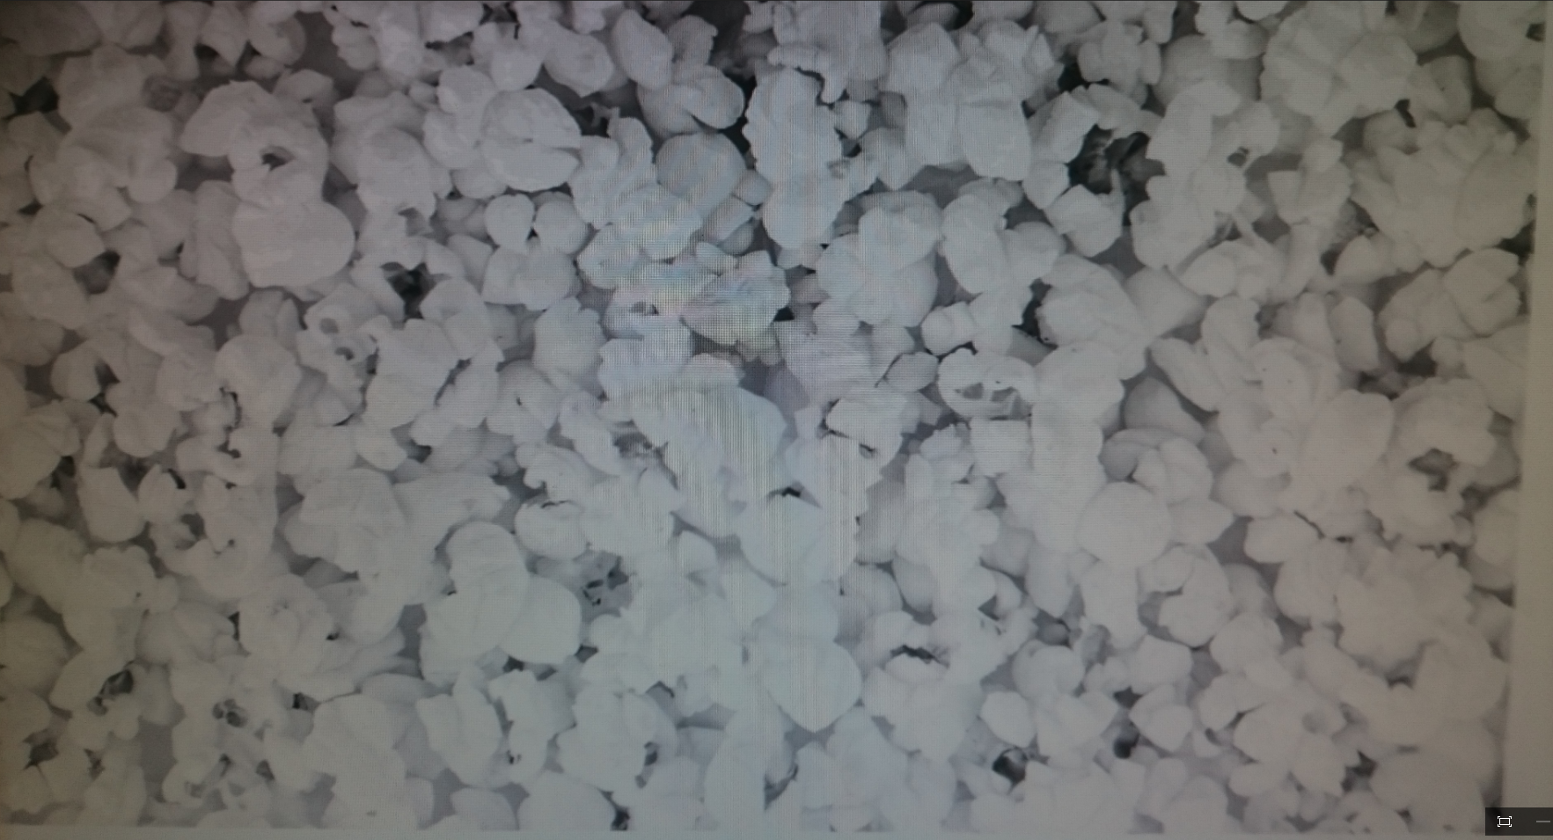

Slide 18
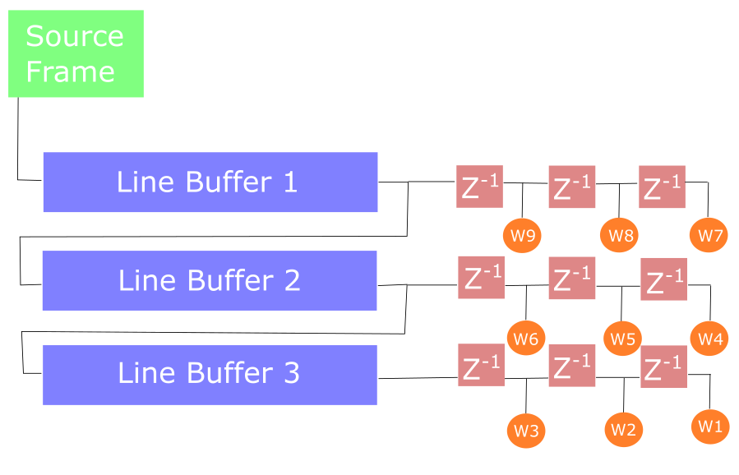
Sobel Filter

Slide 19
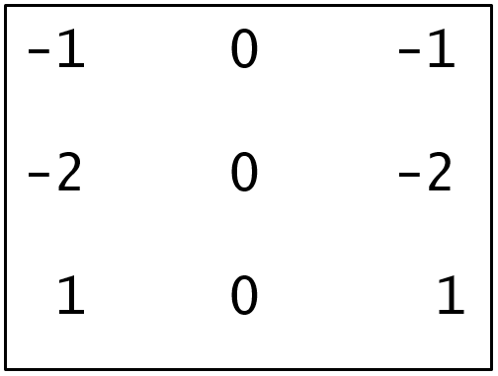
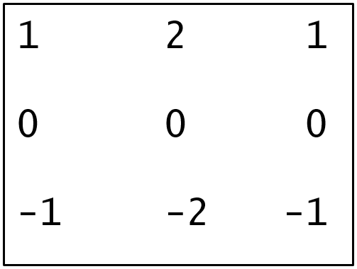
Sobel Filter
Gx
Gy

Slide 20
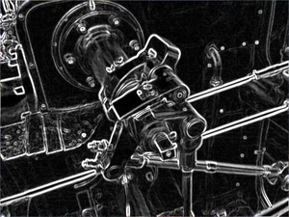
Sobel Filter
G_mag = ABS(Gx) + ABS(Gy)
https://upload.wikimedia.org/wikipedia/commons/thumb/d/d4/Valve_sobel_(3).PNG/300px-Valve_sobel_(3).PNG

Slide 21
Sobel Filter
Future implementation:
Edge thresholding.
Gradient threshold at 100.
>=100 is set as white.
<100 is set as black.

Slide 22
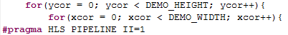
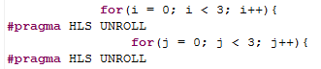
Hardware implementation
Using HLS pragmas:
Pipeline Unroll
Memory attributes and access patterns

Slide 23

Any Questions?

Slide 24


